Slide 1
BWCA September Trip: Lake One
Entry Point 30 - September 2026

Slide 2
Trip Overview
Entry Point: 30 (Lake One)
Dates: Mid-September (Fewer bugs, cooler nights)
Goal: Scenic paddling, fishing, relaxation
Challenge: Wind on large lakes

Slide 3
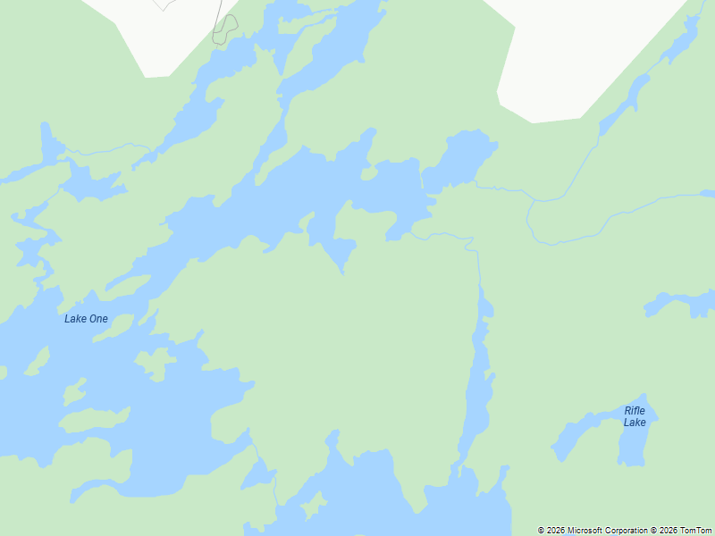
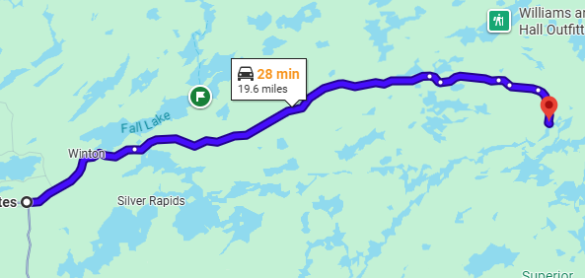
Entry Point Map: EP30 - Lake One
About 30m east from Ely

Slide 4
Plan A: Good Weather
Route: Lake One -> Lake Two -> Lake Three -> Lake Four -> Lake Insula
Daily Travel: 4-6 hours paddling
Activities: Day trip to the Pictographs on Fishdance Lake
Camp: Aim for island sites on Insula for sunset views
Return: Loop back via Hudson if conditions permit

Slide 5
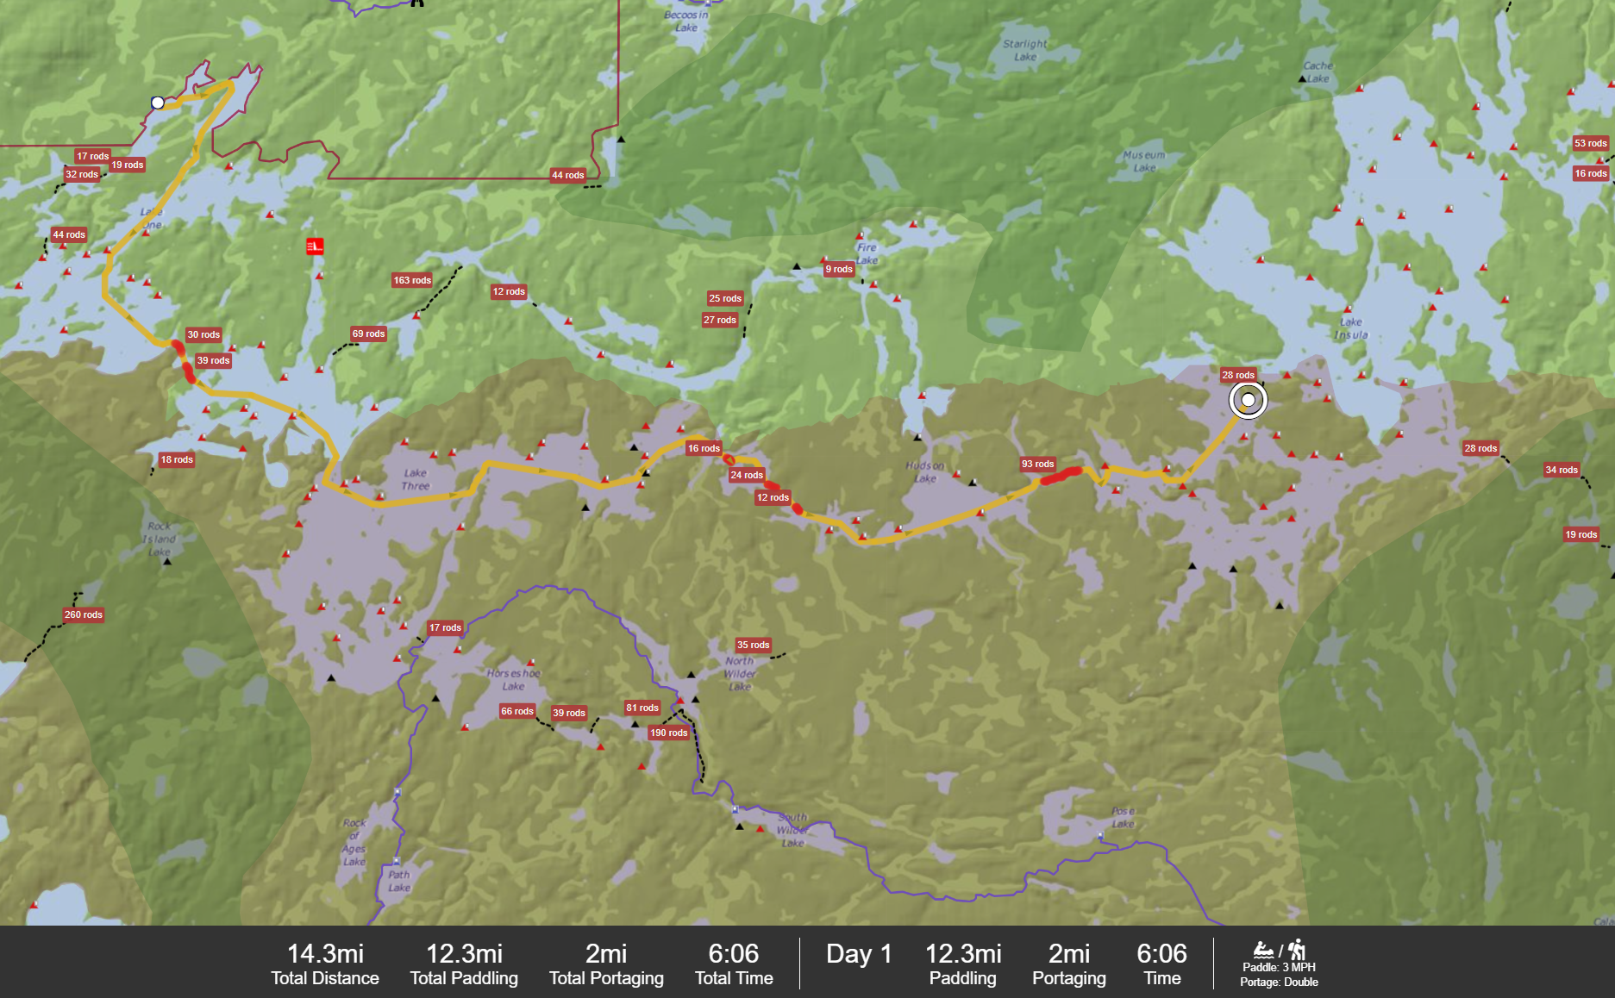
Good Weather Plan

Slide 6
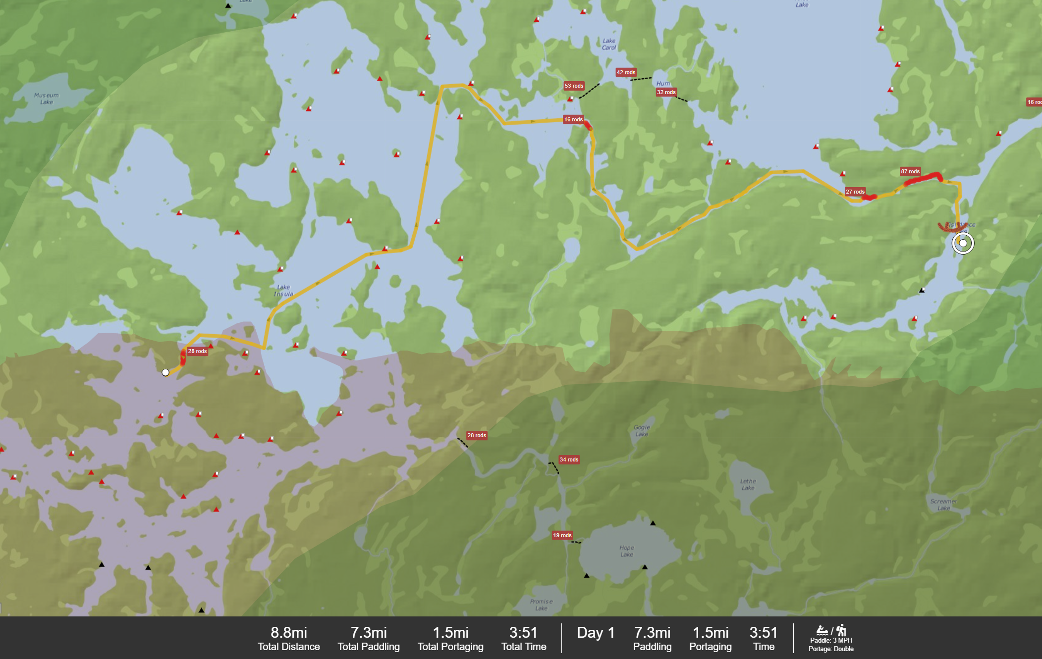
Insula to Pictographs
Notes:
https://bwca.com/index.cfm?fuseaction=forum.thread&threadId=1299490&forumID=12&confID=1

Slide 7
Plan B: Bad Weather (Wind/Rain)
Strategy: Stay safe, minimize open water crossings
Route: Basecamp on Lake One or Lake Two
Activities: Shore fishing, reading, exploring local bays
Camp: Protected sites on Lake Two (avoid west-facing points)
Contingency: If wind is severe, wait it out; do not risk capsizing

Slide 8
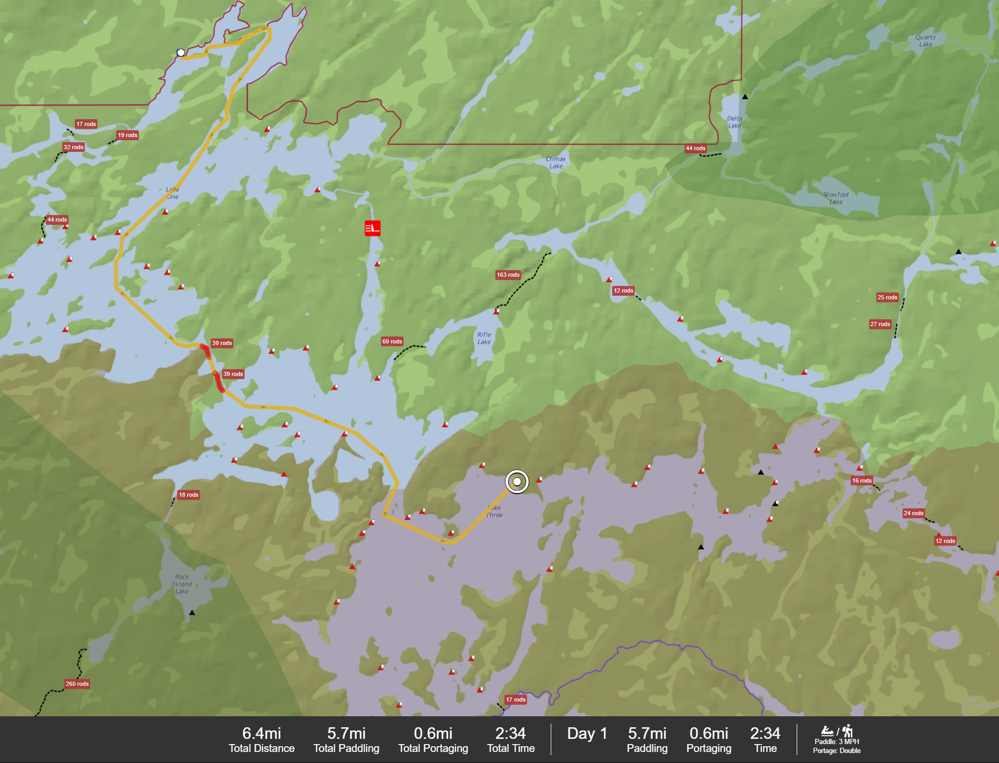
Bad Weather Plans
Many campsites on Northern shore which we could hug if bad weather

Slide 9
September Packing Essentials
Clothing: Wool/Synthetic layers (no cotton), puffy jacket, rain gear
Sleeping: 20°F bag (nights can freeze), insulated pad
Footwear: Wet boots for paddling, dry camp shoes
Gear: Headlamp (earlier sunset), bear canister/hang kit, fire starter
Extras: Camera, book, playing cards for tent time

